Slide 1

Crypto Data Visualization/Statistical Analysis
Sera Biju

Slide 2
Research Question
Can we use crypto data to see if we can estimate the potential rise and fall using correlation and statistical analysis? Can help individuals predict what currency they should invest in?

Slide 3
Description of Data Set
The current data set will be looking over the data of 5 cryptocurrencies over the span of the last 5 years. (This active data set taken directly from Yahoo finances). We will be using the adjusted closing price since this will consider corporate actions such as dividends and splits changing the value of currency.
Dogecoin
Ripple
Bitcoin
Ethereum
Litecoin

Slide 4
Python Tools/Resources
These are python tools I have implemented within my project to display the crypto analysis portfolio.
Pandas Data Reader– to collect the data from yahoo finances directly as an active data set
Pandas – to clear up my adjusted price data into daily accumulated returns of the variations of currency trading prices
Matplotlib & Seaborn– to visualize the different variations of graphs of my statistical analysis.
Facebook Opensource – fbprophet() –to predict potential prices for trading values in 6 months

Slide 5
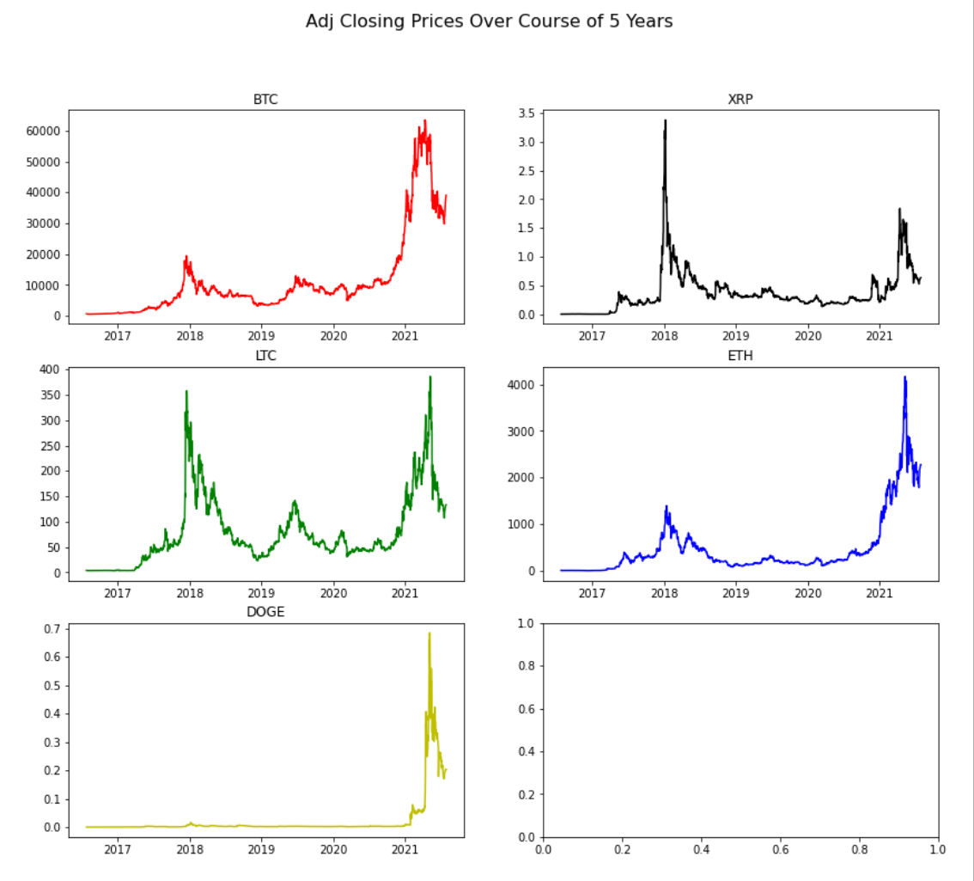
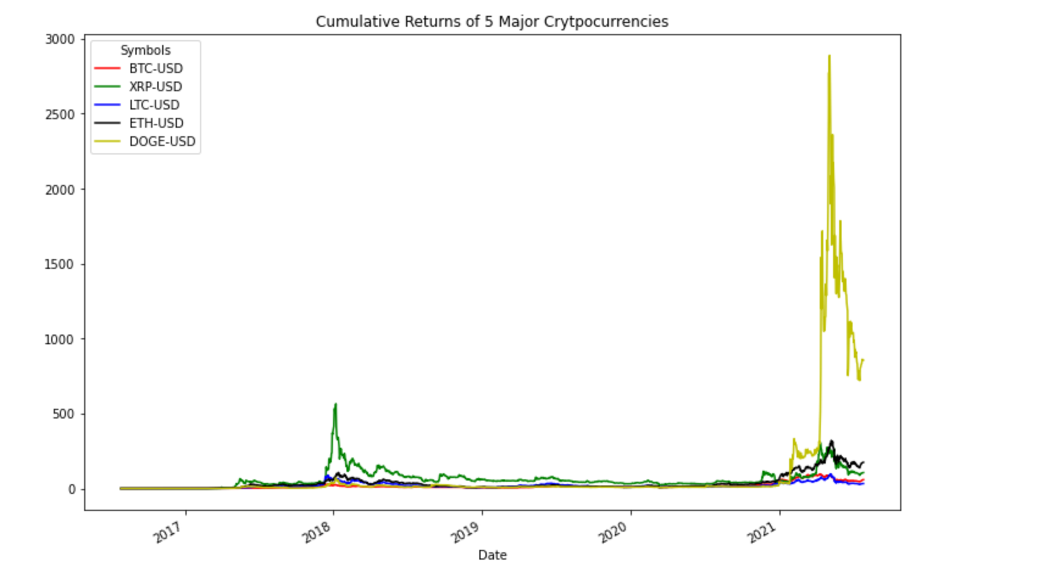
Findings

Slide 6
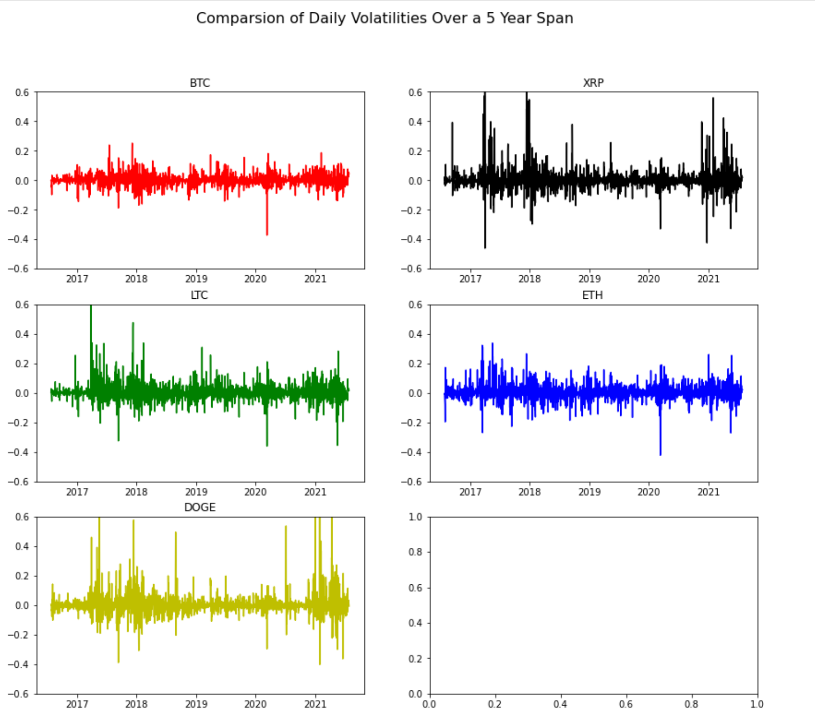
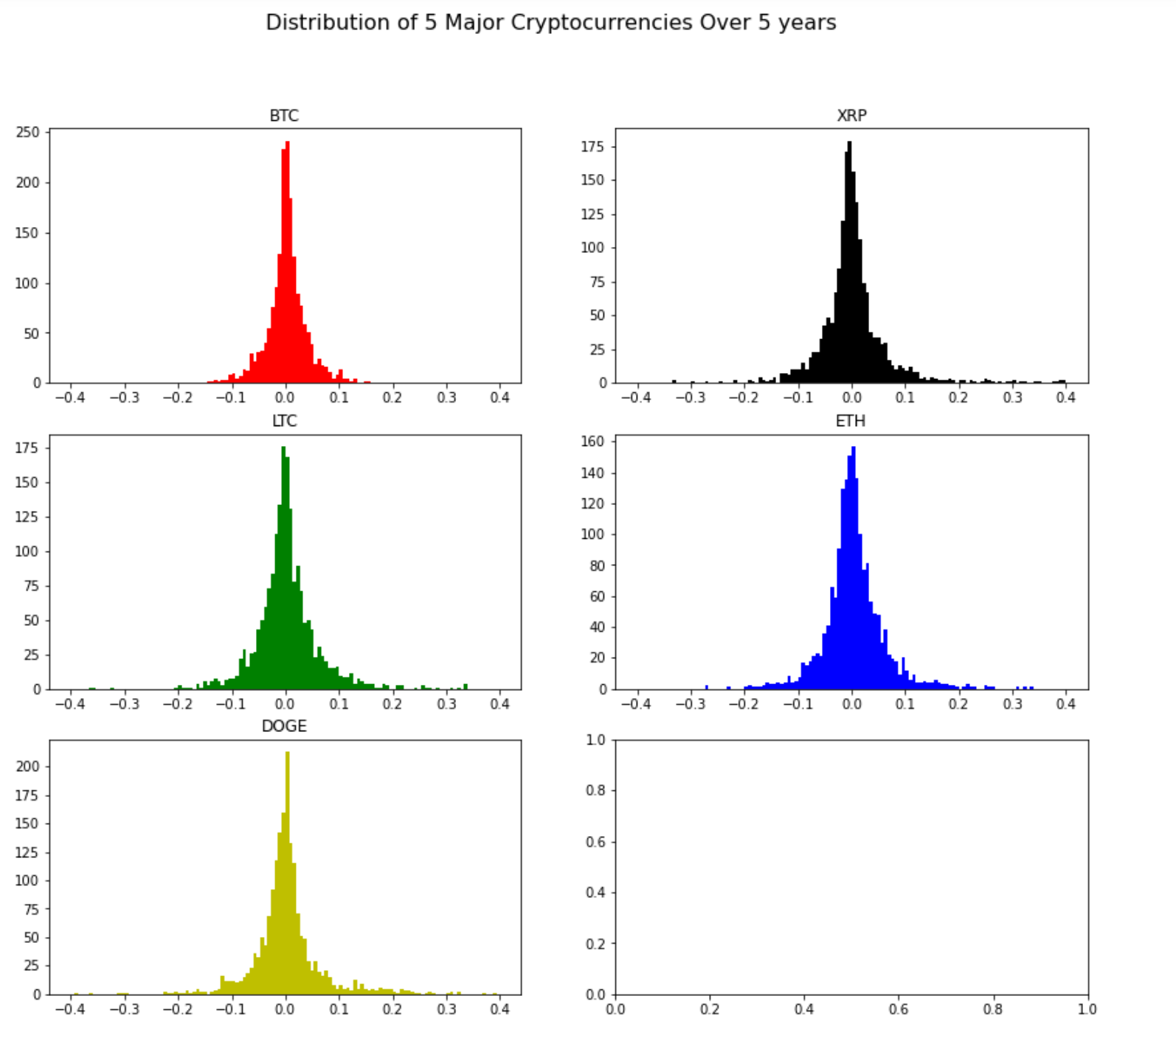
Findings

Slide 7
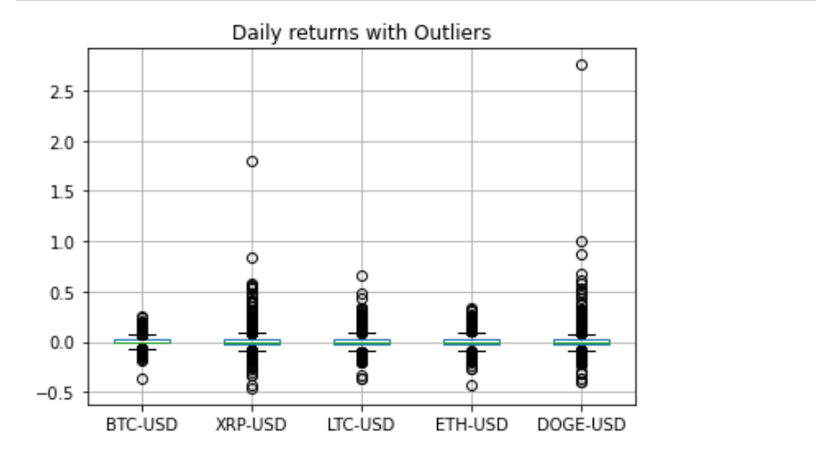
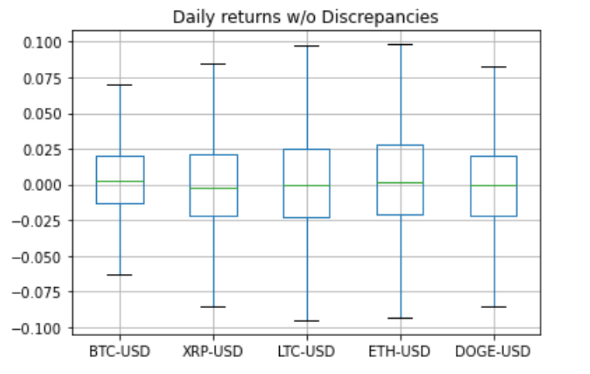
Findings

Slide 8
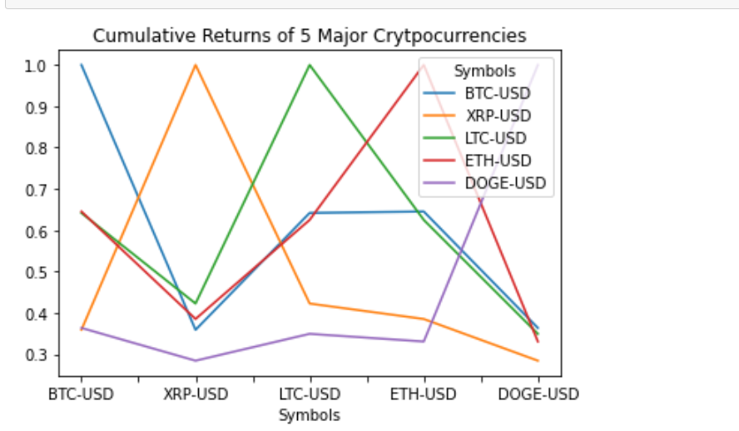
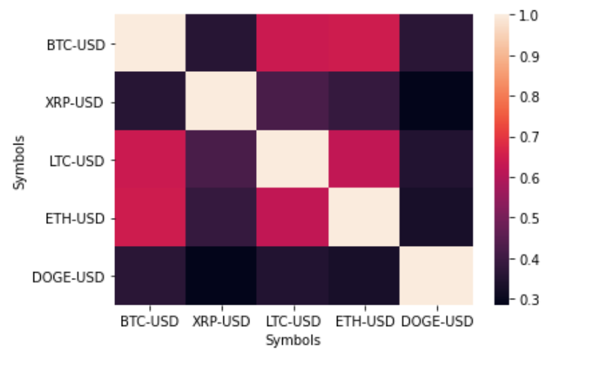
Findings

Slide 9
Findings

Slide 10
Limitations
Current limitations on whether statistical analysis may assist in whether to buy crypto or not will be our current concern, and which form of crypto is the safest bet is another concern. This is mainly a statistical analysis over data from 5 years. Using deep learning and ML algorithms may be another addition to the project that could fairly predict these crypto prices more effectively.

Slide 11
Bibliography
DataSets:
Yahoo Finance Bitcoin - https://finance.yahoo.com/quote/BTC-USD?p=BTC-USD&.tsrc=fin-srch
Yahoo Finance Litecoin - https://finance.yahoo.com/quote/LTC-USD?p=LTC-USD&.tsrc=fin-srch
Yahoo Finance Ripple - https://finance.yahoo.com/quote/XRP-USD?p=XRP-USD&.tsrc=fin-srchYahoo Finance
Dogecoin - https://finance.yahoo.com/quote/DOGE-USD?p=DOGE-USD&.tsrc=fin-srchYahoo Finance
Ethereum- https://finance.yahoo.com/quote/ETH-USD?p=ETH-USD&.tsrc=fin-srch

Slide 12
Bibliography
Python Tutorials and Crypto/Stock Information:
Stock Market Analysis with Pandas Python Programming | Python # 6
Analyzing Cryptocurrencies in Python
Data Science with cryptocurrencies - Analysis & Prediction using Python
Predicting Stock Prices - Learn Python for Data Science #4
How to Predict Stock Prices Easily - Intro to Deep Learning #7
Deep Reinforcement Learning on Stock Data
Facebook Opensource – fbprophet()

